Slide 1

General Models for Sequential Circuits
ECE 2372 | Modern Digital System Design | Texas Tech University

Slide 2
Lecture Overview
Mealy Circuit Model
Moore Circuit Model
Verilog Design Patterns

Slide 3
Mealy Circuit Model
General Models for Sequential Circuits | Modern Digital System Design

Slide 4
Mealy Circuit Model
Recall that a Mealy Circuit is a sequential logic circuit whose outputs are Boolean functions of both the present-state and the inputs.

Slide 5















Mealy Circuit Model
$$X_{1}$$
Combinational Logic Circuit
$$F_{1}$$
$$X_{2}$$
$$F_{2}$$
.
.
.
.
.
.
$$X_{M}$$
$$F_{N}$$
$$Q_{1}^{+}$$
$$Q_{1}$$
$$Q_{1}$$
FF1
$$Q_{2}^{+}$$
$$Q_{2}$$
.
.
.
$$Q_{2}$$
.
.
.
FF2
.
.
.
$$Q_{K}$$
$$Q_{K}$$
$$Q_{K}^{+}$$
FFK

Slide 6

Mealy Circuit Model
The Mealy Circuit is defined by $N+K$ Boolean functions of $M+K$ variables.
$$F_{1}=f_{1}\left(X_{1},X_{2}, …X_{m}, Q_{1}, Q_{2}, …, Q_{K}\right)$$
$$F_{2}=f_{2}\left(X_{1},X_{2}, …X_{m}, Q_{1}, Q_{2}, …, Q_{K}\right)$$
. . .
$$F_{N}=f_{N}\left(X_{1},X_{2}, …X_{m}, Q_{1}, Q_{2}, …, Q_{K}\right)$$
$$Q_{1}^{+}=q_{1}(X_{1},X_{2}, …X_{m}, Q_{1}, Q_{2}, …, Q_{K})$$
$$Q_{2}^{+}=q_{2}\left(X_{1},X_{2}, …X_{m}, Q_{1}, Q_{2}, …, Q_{K}\right)$$
. . .
$$Q_{K}^{+}=q_{K}\left(X_{1},X_{2}, …X_{m}, Q_{1}, Q_{2}, …, Q_{K}\right)$$

Slide 7

What questions do you have?

Slide 8
EXAM QUESTION: MEALY CIRCUIT MODEL
If a Mealy Circuit has a 4-bit input, 12 states, and a 4-bit output, then it will be defined by how many Boolean functions of how many variables?
12 Boolean functions of 8 variables
16 Boolean functions of 8 variables
8 Boolean functions of 8 variables
8 Boolean functions of 16 variables

Slide 9
EXAM QUESTION: MEALY CIRCUIT MODEL
If a Mealy Circuit has a 4-bit input, 12 states, and a 4-bit output, then it will be defined by how many Boolean functions of how many variables?
12 Boolean functions of 8 variables
16 Boolean functions of 8 variables
8 Boolean functions of 8 variables
8 Boolean functions of 16 variables
12 states -> 4 Flip-Flops (K = 4)
4-bit input (M = 4)
4-bit output (N = 4)
N + K Boolean functions of N + K variables.
4 + 4 = 8 Boolean functions of 4 + 4 = 8 variables.

Slide 10
Moore Circuit Model
General Models for Sequential Circuits

Slide 11
Moore Circuit Model
Recall that a Moore Circuit is a sequential logic circuit whose outputs are Boolean functions of only the present-state.

Slide 12















Moore Circuit Model
$$X_{1}$$
Combinational Logic Circuit
$$X_{2}$$
.
.
.
$$X_{M}$$
$$Q_{1}$$
$$Q_{1}^{+}$$
Combinational Logic Circuit
$$Q_{1}$$
FF1
$$F_{1}$$
$$Q_{2}^{+}$$
$$Q_{2}$$
$$Q_{2}$$
$$F_{2}$$
.
.
.
.
.
.
FF2
.
.
.
.
.
.
$$Q_{K}$$
$$F_{N}$$
$$Q_{K}^{+}$$
FFK
$$Q_{K}$$

Slide 13
Moore Circuit Model
The function space of a Moore Circuit is slightly different.
There will be K next-state equations of M + K variables
There will be N output equations of K variables.

Slide 14
What questions do you have?

Slide 15
EXAM QUESTION: Moore Circuit Model
If a Moore sequential circuit has a 4-bit input, 12 states, and a 4-bit output, how many output equations of how many variables will be needed?
4 output equations of 4 variables
4 output equations of 12 variables
4 output equations of 8 variables
4 output equations of 16 variables

Slide 16
EXAM QUESTION: Moore Circuit Model
If a Moore sequential circuit has a 4-bit input, 12 states, and a 4-bit output, how many output equations of how many variables will be needed?
4 output equations of 4 variables
4 output equations of 12 variables
4 output equations of 8 variables
4 output equations of 16 variables

Slide 17
Verilog Design Patterns
General Models for Sequential Circuits | Modern Digital System Design

Slide 18
Lecture Recap
Mealy Circuit Model
Moore Circuit Model
Verilog Design Patterns

Slide 19
Verilog Design Patterns
Design patterns are common in all programming languages.
They provide a standardized framework for approaching open-ended programming problems.
We’ll use two slightly different patterns for Mealy and Moore sequential logic circuits.

Slide 20
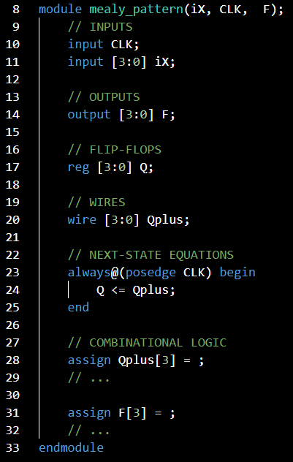
Mealy Design Pattern

Slide 21
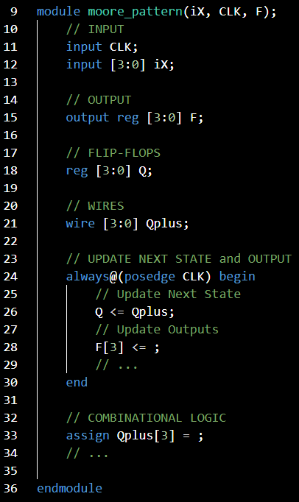
Moore Design Pattern

Slide 22
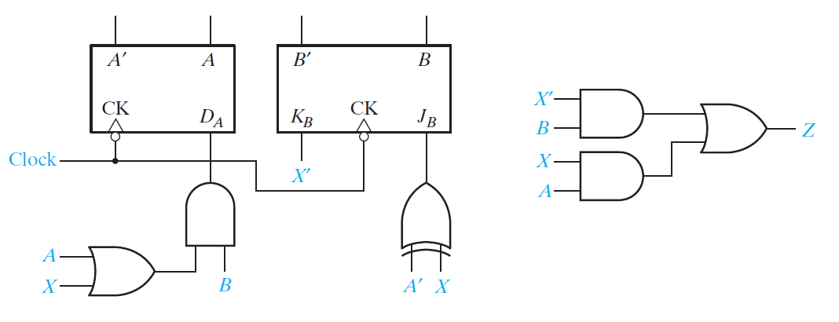
Design Patterns | Example
Use a design pattern to implement the following circuit in Verilog.

Slide 23

This is a Mealy Circuit.
$$M=1, K=2, N=1$$

Slide 24






$$Z\left(X, A, B\right)=X^{′}B+XA$$
$$D_{A}\left(X, A, B\right)=B(A+X)$$
$$J_{B}\left(X, A, B\right)=A^{′} ⨁ X$$
$$K_{B}\left(X, A, B\right)=X′$$
$$A=D_{A}$$
$$B=J_{B}B^{′}+K_{B}^{′}B$$

Slide 25
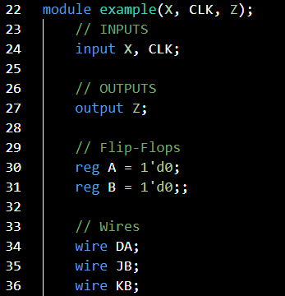
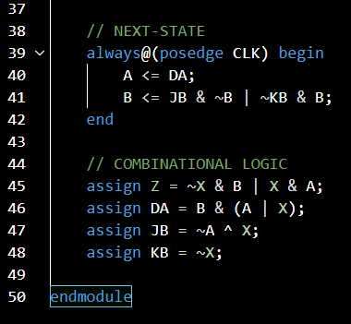

Slide 26
What questions do you have?

Slide 27
General Models for Sequential Circuits
ECE 2372 | Modern Digital System Design | Texas Tech University

